Slide 1

Genome Information SPoT Pharma Research and Early Development Informatics Technical Operations & Solution Delivery, Roche Innovation Center Basel
David Herzig
BIO IT World – Next Gen Sequencing- 17th May 2018

Slide 2
Agenda
Introduction (Roche, Speaker)
Common IT Landscape Problems, SPoT (SSoT)
Evaluation
Solution
Use Cases
Questions

Slide 3
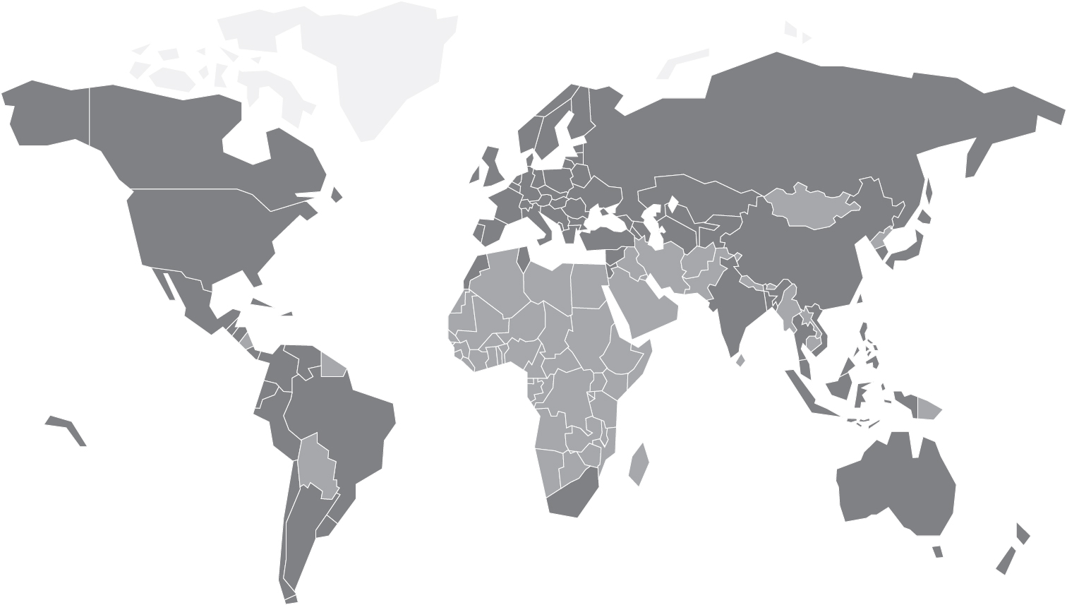
Roche - a global pioneer in pharmaceuticals and diagnostics
Among top 10 R&D investors worldwide across industries
employees* worldwide
94 052
major R&D sites in pharma and diagnostics worldwide
22
CHF 9.9
billion invested
in innovative R&D
CHF 50.6 billion sales
Direct Roche commercial presence
Commercial distributors
Roche Group Headquarters in Basel, Switzerland
R&D sites in Pharma and Diagnostics
Genentech, R&D and commercial operations US
Chugai, R&D and commercial operations Japan
* Employee numbers in FTE (full time equivalent)
Notes:
Data is derived from Roche Annual Report for 2016
We are a global pioneer in pharmaceuticals and diagnostics dedicated to advancing science to improve human health in meaningful ways. We do this by creating insights and innovations that contribute to the progress of medicine and healthcare.
In 2016, we had 94,052 employees* (number is in full time equivalent – FTE) worldwide: we are many working as one, headquartered in Switzerland, yet open to the world. We tackle obstacles in healthcare and work across disciplines (science (biology), informatics, technologies) and cultures. We embrace risks. This is how we transform lives, provide cures, comfort and hope to people today.
A strong, decentralised worldwide network of 22 R&D sites in pharma and diagnostics makes us quite unique: focused on advancing science so that it benefits patients and healthcare/medical practice. The following are the R&D sites worldwide: North America (9) Pharma (SSF, NY, Mississauga, Cambridge) Dia (Pleasanton, SF Bay Area (Mountain View), Tucson, Indianapolis, Boston Area); Europe (10) Pharma (Zurich, Copenhagen, Basel, Welwyn) Dia (Mannheim, Penzberg, St Cugat, Rotkreuz, Berlin (Swisslab), Waiblingen (PVT); Asia (3) Pharma (Shanghai, Tokyo, Singapore). .
In 2016, we invested CHF 9.9 billion into research and development. This is among the top investors into research and development across industries (including Google, etc.) Our research and development spend is focused on advancing science / healthcare. This research spend represents 1/5 of our sales.
2016 was another successful year with many scientific advances, made possible by a solid financial foundation, which was further strengthened by sales amounting to CHF 50.6 billion.

Slide 4
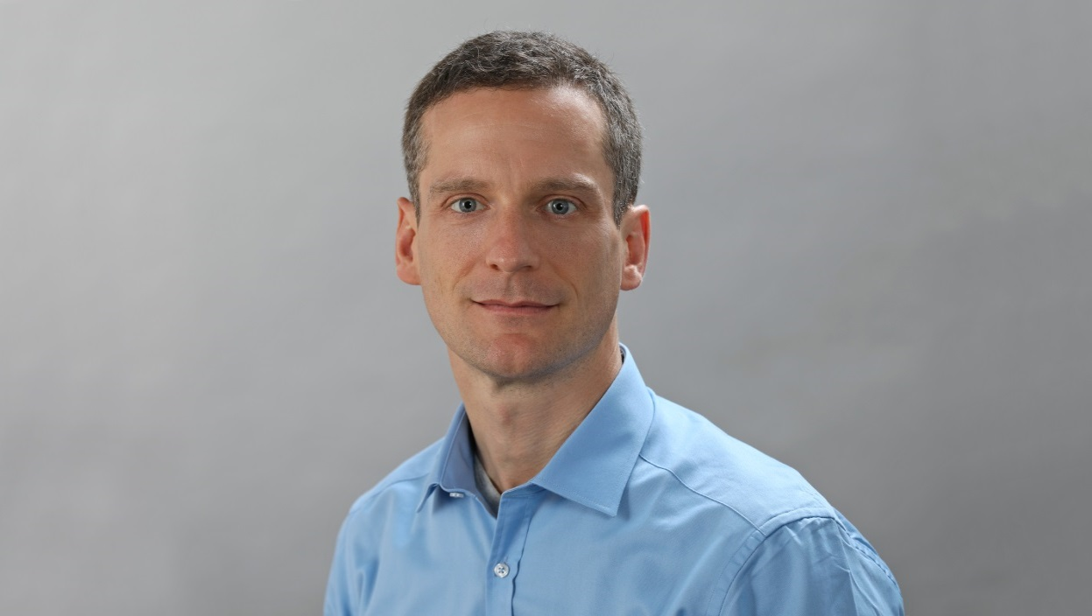
Meet the speaker
David Herzig Title: Senior Scientist Company: F. Hoffmann – La Roche Summary: Experienced Research Scientist with a demonstrated history of working in the computational research pharma industry. Skilled in Python, Java, Bioinformatics, C++ and Big Data. Strong research professional focused in Computer Science, Computational Biology and Data Science Hobbies: Family, Sport (Running and Cycling)

Slide 5


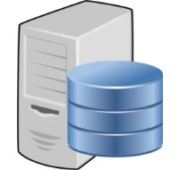





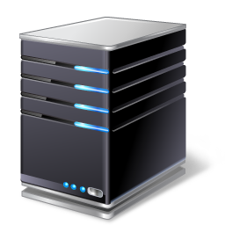



Common System Landscapes
Data Sources
System A (inhouse)
Data Processing
REST API
Consumer 1 (Bioinformatics) e.g. BLAST Search
System B (vendor X)
Data Processing
Proprietary API
Consumer 2 (Data Science) Deep Learning
System C (customized)
Filesystem (Fasta, GFF, GTF3), Oracle, MySQL, NoSQL
Data Processing
Database Access
Consumer 3 (JBrowse) e.g. Visualize

Slide 6


Common System Landscapes
Data Sources
System A (inhouse)
Data Processing
REST API
Consumer 1 (Bioinformatics) e.g. BLAST Search
System B (vendor X)
Data Processing
Proprietary API
Consumer 2 (Data Science) Deep Learning
System C (customized)
Filesystem (Fasta, GFF, GTF3), Oracle, MySQL, NoSQL
Data Processing
Database Access
Consumer 3 (JBrowse) e.g. Visualize

Slide 7

Common Problems
So many duplicates! Which is up to date?
When did this policy change?
Spaghetti Integration
Data Duplication
Effort Duplication
Data Quality
Workflows are slow
Data version
De-Normalization
High maintenance effort
Hurdles: Complex Systems, Stakeholders, Technical Challenges
Why can’t everything just be in the same place?
Do I check SharePoint? Intranet?
My cheat sheet is different to yours!
I just need the right answer!

Slide 8
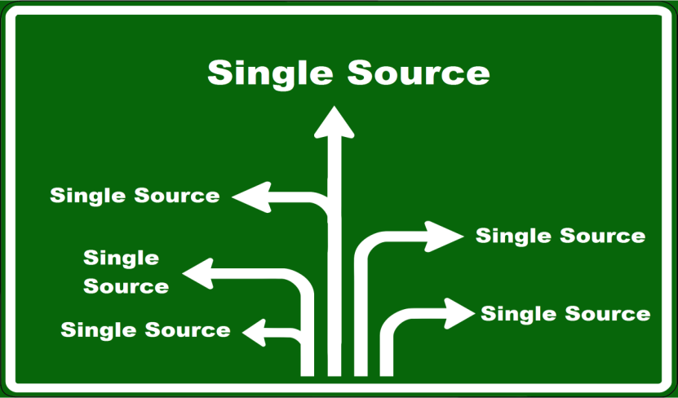
Single Source of Truth
A single source of truth is the practice of storing data in a way, that every data element is stored exactly once.
Everyone in the company agrees, this data is the only “real data”
The link to a data element is by reference only
Moving away from silo solutions

Slide 9
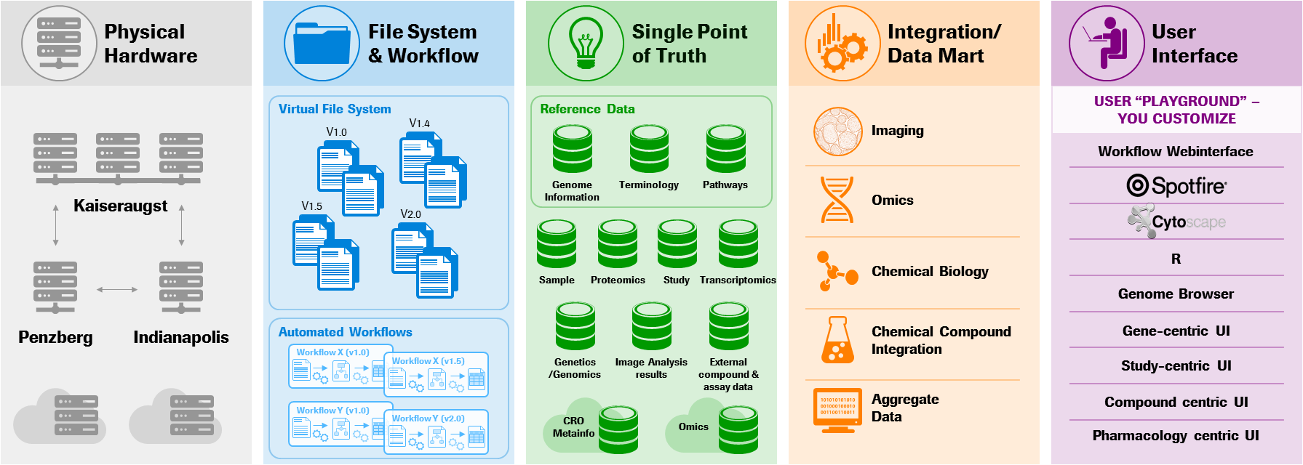
Single Source of Truth Roche Data Commons

Slide 10

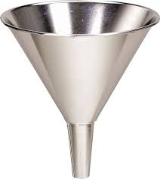




Single Source of Truth
Filesystem (Fasta, GFF, GTF3), Oracle, MySQL, NoSQL
Load & process data
API
API
Consumer 1 e.g. Deep Learning
Consumer 2 e.g. BLAST Search
Data Storage

Slide 11
Requirements - Functional
Species: Human (H Sapiens), Rat (R Novegicus), Mouse (M Musculus), Pig (S Scrofa), Minipig (S Scrofa Domesticus), Cynomolgus (M Fascicularis), Zebrafish (D Rerio)
Support multiple genome drafts
Homo Sapiens GRCh 37
Homo Sapiens GRCh 38
Sources: Ensembl, Entrezgene/Refseq, Swissprot, Roche Inhouse
Genes, Transcripts, Proteins, Exons
Mapping between Ensembl & Entrezgene
Comparative Genomics
… and many more …

Slide 12
Requirements - Technical
Fits into the Roche pREDi IT architecture
API
REST
R Interface
Pipeline Pilot Interface
Python Interface
Support Arvados Platform (https://curoverse.com/)

Slide 13

Evaluation
Off the rack, open source, taylor-made or inhouse development?
Cost
Features
Meet business needs
Available user communities for self help support
Quick to deploy
Maintenance effort
Vendor Lock
…

Slide 14
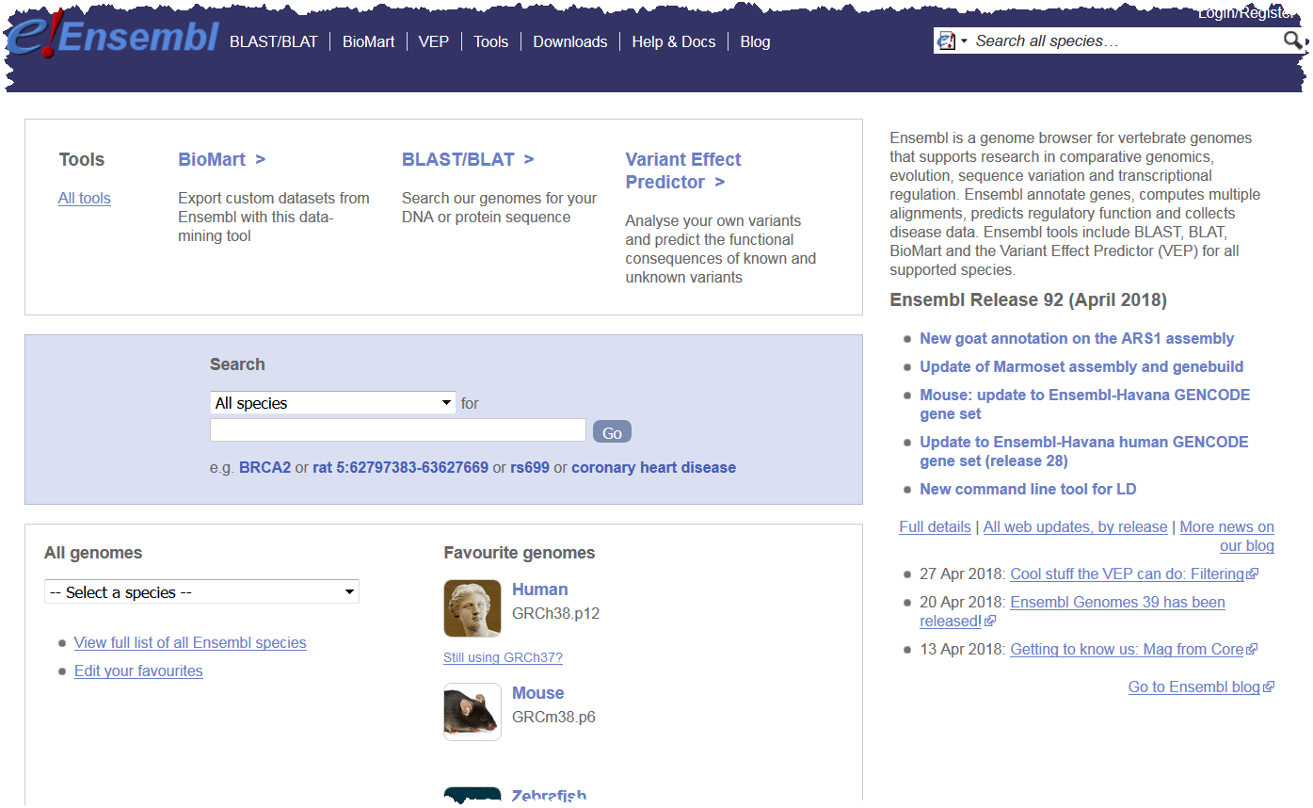
Ensembl
What is ensembl Ensembl is a genome browser for vertebrate genomes that supports research in comparative genomics, evolution, sequence variation and transcriptional regulation. Ensembl annotate genes, computes multiple alignments, predicts regulatory function and collects disease data. Ensembl tools include BLAST, BLAT, BioMart and the Variant Effect Predictor (VEP) for all supported species.
www.ensembl.org

Slide 15
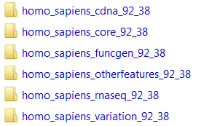
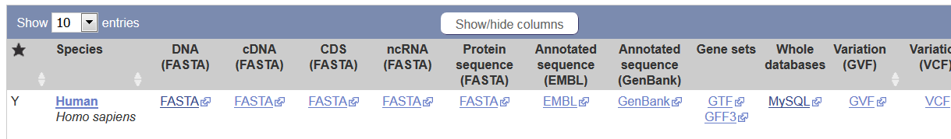
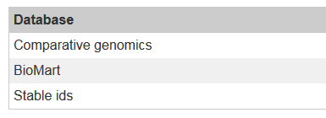

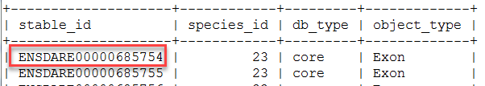

Ensembl
Available ensembl components
Genomics reference data for many species
Multi species databases
API & Software
PERL Api, REST, Tools, Web Code

Slide 16
Ensembl
Available databases for many species
cdna cDNA to genome alignments
core General genome annotation information
funcgen Regulation information
otherfeatures Additional genome annotation
rnaseq Gene models built from rnaseq data
variation Genetic variation information
vega Manually curated gene sets

Slide 17
Solution – Ensembl data
One general script, performing the following steps:
The following input parameters are defined
load.sh ${ENSEMBL_VERSION} ${DB_HOST} ${DB_USER} ${DB_PW} ${DOWNLOAD_DIR} ${SPECIE} ${DRAFT} ${DB}
E.g. load.sh 92 mysql.roche.com:3306 mysql_user mysql_pw /tmp homo_sapiens 38 core
Special case for databases without species: e.g. COMPARA, STABLE_IDS, ONTOLOGY, …
Download data (.txt.gz files)
Create new databases (mysql create & grant)
Setup database e.g. hs_core_92_38.sql
Unzip Data
Import Data
SPoT (SSoT)

Slide 18
Solution – Ensembl data
One script for each Specie, Database, Draft and Ensembl Version
Specie (N) | DB Component (M)
Human (37 & 38) | Core
Mouse | Variation
Rat | Funcgen
Pig | otherfeatures
Zebrafish
Cynomolgus
Loading Log
loadMouseCore.sh
loadMouseVariation.sh
loadMouseFuncgen.sh
loadMouseOtherFeatures.sh
….
#Scripts = N_species * M_components

Slide 19
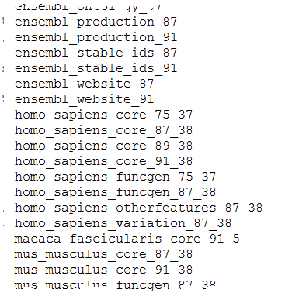

Solution – Ensembl data
Available databases after loading all ensembl db’s
Time used to setup all databases for all species for one ensembl version: ~ 150 hours

Slide 20
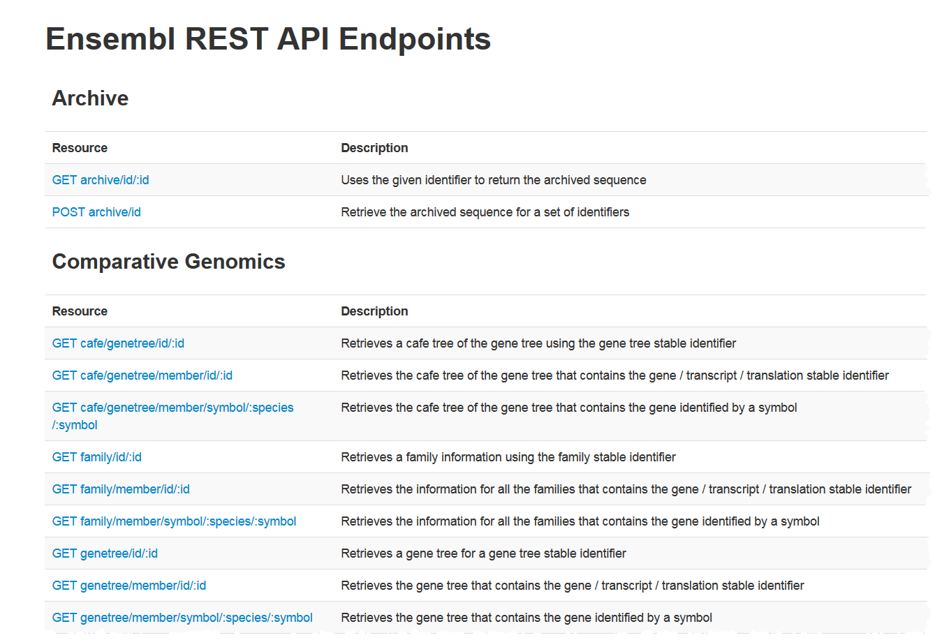
Solution – Ensembl software
git clone https://github.com/Ensembl/ensembl.git git clone https://github.com/Ensembl/ensembl-compara.git git clone https://github.com/Ensembl/ensembl-variation.git git clone https://github.com/Ensembl/ensembl-funcgen.git git clone https://github.com/Ensembl/ensembl-analysis.git git clone https://github.com/Ensembl/ensembl-io.git git clone https://github.com/Ensembl/ensembl-pipeline.git git clone https://github.com/Ensembl/ensembl-rest.git git clone https://github.com/Ensembl/ensembl-doc.git git clone https://github.com/Ensembl/ensembl-external.git git clone https://github.com/Ensembl/ensembl-production.git git clone https://github.com/Ensembl/ensembl-vep.git

Slide 21
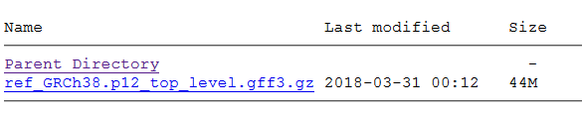
Solution – NCBI data
One general script, performing the following steps:
The following input parameters are defined
load.sh ${DB_HOST} ${DB_USER} ${DB_PASS} ${DB}_${ENSEMBL_VERSION}_${DRAFT} ${DOWNLOAD_DIR} ${ENSEMBL_DIR} ${FILENAME}
E.g. load.sh mysql.roche.com:3306 mysql_user mysql_pw homo_sapiens_core 92 38 /tmp /home_ensembl ref_GRCh38.p12_top_level.gff3.gz
Download data (.gff3.gz files)
Unzip Data
Import Data (Ensembl Perl Script)
SPoT (SSoT)
https://ftp.ncbi.nlm.nih.gov/genomes/H_sapiens/GFF/

Slide 22
Solution – NCBI data
One script for each Specie (only core component)
Specie (N) | DB Component (1)
Human (37 & 38) | Core
Mouse
Rat
Pig
Zebrafish
Cynomolgus
Loading Log
loadNCBIMouse.sh
loadNCBIRat.sh
loadNCBIPig.sh
loadNCBICyno.sh
….
#Scripts = N_species * 1

Slide 23
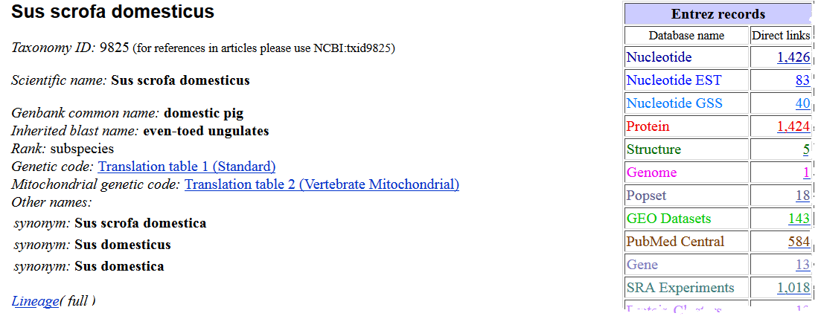
Solution – inhouse data
One general script, performing the following steps:
Check data
Convert fasta files genome.fa
Create new database (mysql create & grant)
Create AGP
Create scaffolds
Create contigs
Link scaffolds & contigs
Update meta table
SPoT (SSoT)
chr[1-19,X,Y].fasta GFF3 File
https://www.ncbi.nlm.nih.gov/Taxonomy/Browser/wwwtax.cgi?id=9825

Slide 24
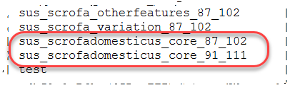
Solution – inhouse data
Available database after loading inhouse data

Slide 25

Solution - Arvados
Fasta, GFF, GTF
Some data (e.g. Fasta files) is duplicated into the Arvados environment, mainly due to performance reasons and Arvados is a Roche standard!
Load & process data
API
API
Consumer 1 e.g. Deep Learning
Consumer 2 e.g. BLAST Search
Data Storage

Slide 26


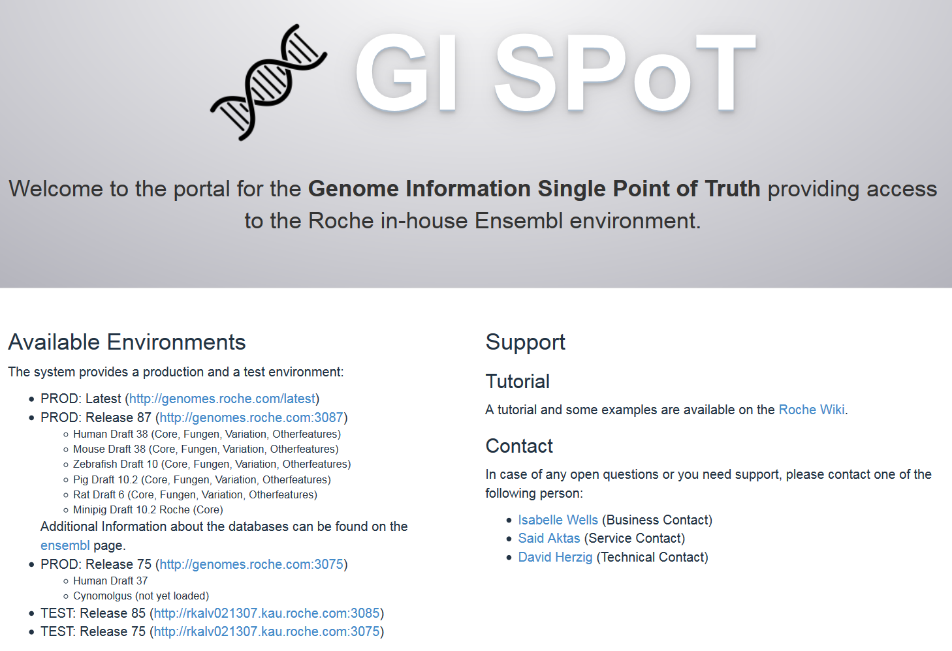

Solution
Never change data manually!
Load & process data
Automatic with the provided scripts.
Ensembl data
NCBI data
Inhouse data
Admin
2 Updates / year 5 versions are available in parallel
Ensembl REST Interface
http://genomes.roche.com:3091/ http://genomes.roche.com/latest
User

Slide 27
Solution

Slide 28
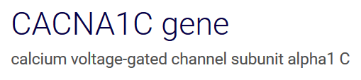
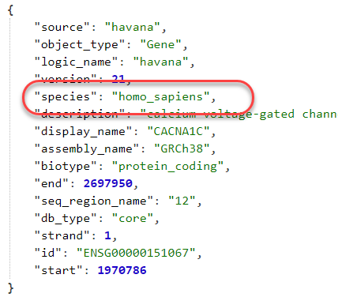
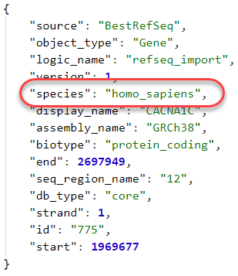
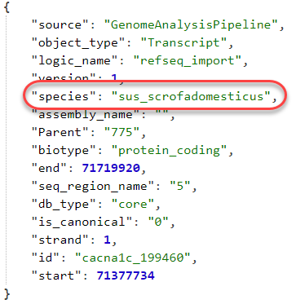
Use Cases
Lookup gene, transcript (Ensembl, Entrezgene, Roche)
Ensembl Gene: Entrez Gene: Roche Inhouse ENSG00000151067 775 cacna1c_199460

Slide 29
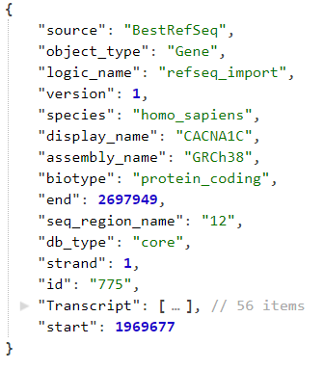
Use Cases
List transcript / exons for a given gene
Entrez Gene: 775

Slide 30
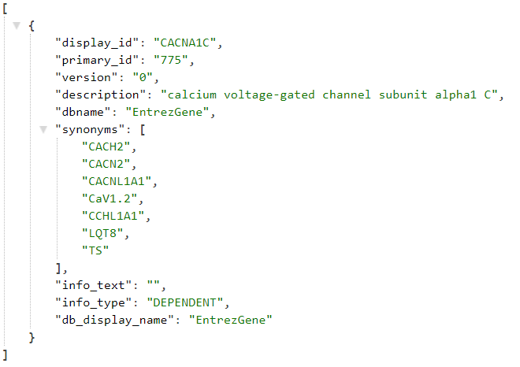
Use Cases
Give a Ensembl Gene Id, retrieve Entrez Gene Id
Ensembl Gene: ENSG00000151067

Slide 31


Slide 32
Doing now what patients need next

